Slide 1
Chapter 13: Curves in 3D
Fletcher Dunn
Valve Software
Ian Parberry
University of North Texas
3D Math Primer for Graphics & Game Development

Slide 2
What You’ll See in This Chapter
This chapter is about how to represent curves mathematically in 3D. It is divided into nine sections.
Section 13.1 is about parametric polynomial curves.
Section 13.2 talks about polynomial interpolation.
Section 13.3 introduces Hermite curves.
Section 13.4 looks at Bézier curves.
Section 13.5 is about subdivision.
Section 13.6 introduces splines.
Section 13.7 examines Hermite and Bézier splines.
Section 13.8 discusses continuity.
Section 13.9 is about automatic tangent control.

Slide 3
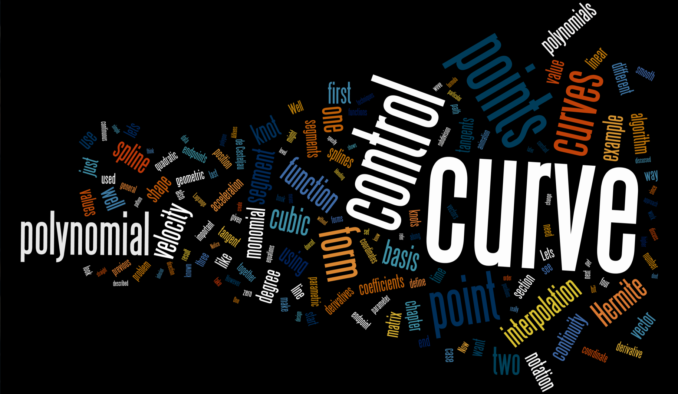
Word Cloud

Slide 4
Section 13.1: Parametric Polynomial Curves

Slide 5
Section 13.2: Polynomial Interpolation

Slide 6
Section 13.3: Hermite Curves

Slide 7
Section 13.4: Bézier Curves

Slide 8
Section 13.5: Subdivision

Slide 9
Section 13.6: Splines

Slide 10
Section 13.7: Hermite and Bézier Splines

Slide 11
Section 13.8: Continuity

Slide 12
Section 13.9: Automatic Tangent Control

Slide 13

That concludes Chapter 13. And it also concludes the 3D Math Primer

